Slide 1
VENUE RECOMMENDATION
- A CONTENT BASED RECOMMENDATION APPROACH USING FOURSQUARE PLACES API DATA

Slide 2
Venue recommendation can be leveraged by both users and businesses alike
Being able to predict what a person will like based what he has liked in the past is powerful
Explorers can make the best of their time in a new place by visiting the places they like.
Businesses can proactively provide more personalized services to customers.
Businesses can forge and leverage business partnerships based on the profiles of regular customers.

Slide 3
Data Sources and pre-processing
The primary source of data for this project is Foursquare Places API
The following Foursquare Places API Endpoints have been used
Venues->explore
Users->lists
Lists->Details
Data scraping and cleansing to only retain relevant features like Venue Name, Location details, Venue Categories and Neighborhood.
Remove Venue Categories that are not necessary.

Slide 4
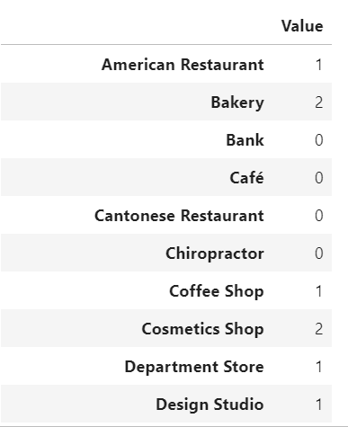
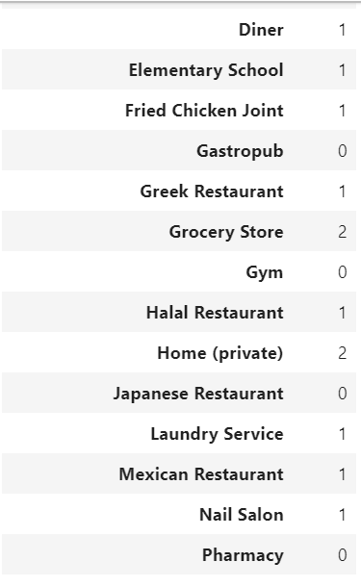
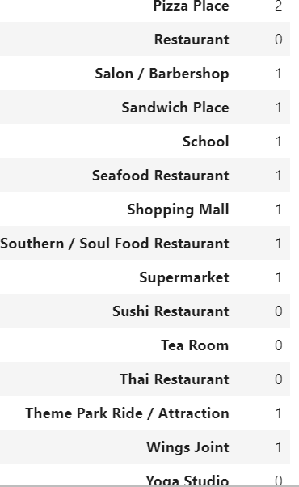
Understand the user in focus by understanding what venues he has liked
Retrieved the list of venues a user has liked from Foursquare
Got the combined Venue Category list from the users liked venues and the venues to rank
Create a user profile by finding the weight of each Venue category in the list.

Slide 5
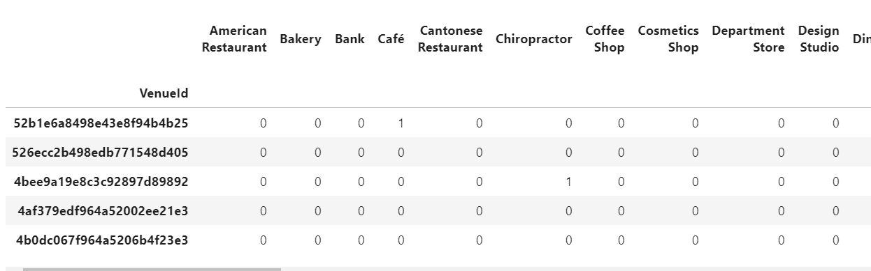
Prepare the data to rank the venues in the area of interest
Retrieved the list of venues in the area of interest from Foursquare
Got the combined Venue Category list from the users liked venues and the venues to rank
Create a feature matrix that contains each Venue in the list of venues to rank.

Slide 6
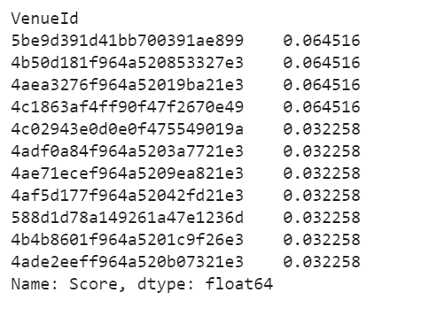
Use Content based recommendation strategy to assign scores to the venues
Performed matrix calculations to achieve a single score for each venue based on the user profile
Drop all venues that have a score = 0
Retain only the top N recommendations if the list is very large

Slide 7
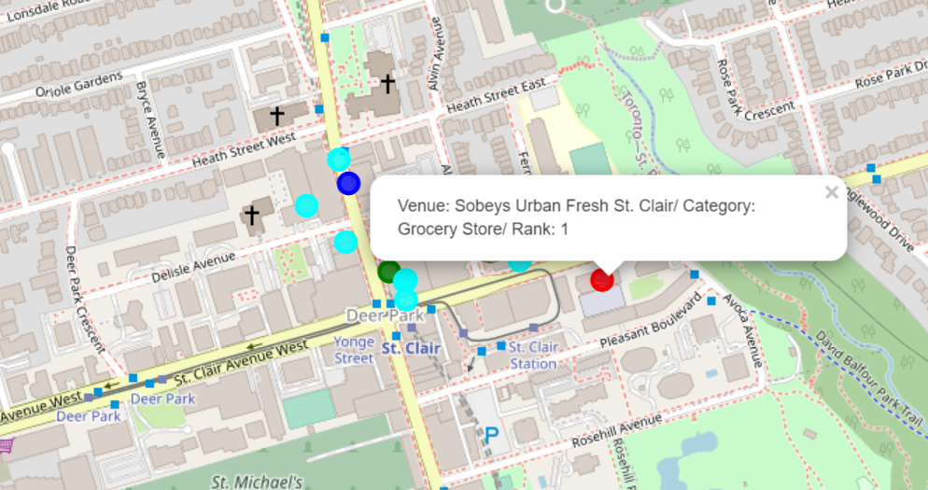
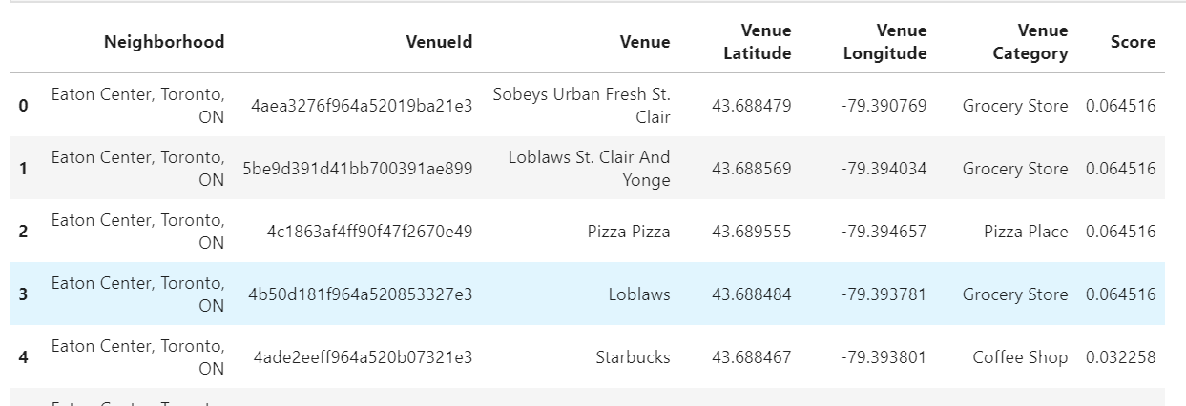
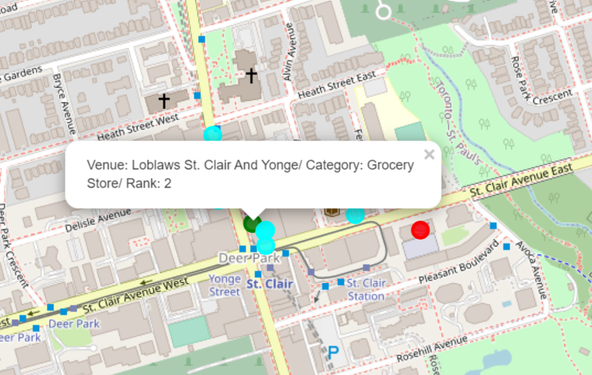
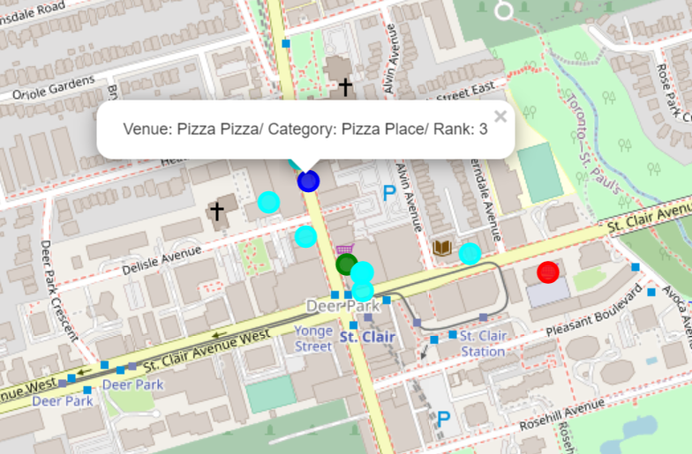
Present the data back …
Use maps to visualize venue locations
Use a simple list to provide venue details along with the rank
Highlight top recommendations using color and callouts

Slide 8
This is just the beginning, opportunities for enhancement are limitless..
This model uses Venue categories as a feature, but a more complete profile can be created using attributes that can be extracted from premium endpoints.
The content-based recommendation approach is heavily dependent on historical likes and does not address new recommendations that a user could try. A collaborative filtering strategy can help address this issue.
The model can be fine-tuned to focus on specific categories and areas of interest e.g. food, tourist attractions, etc.

